Slide 1
Unit-II Standards and Guidelines

Slide 2

STANDARDS
Set by national or international bodies to ensure compliance with a set of design rules by a large community.
Underlying theory – Hardware
based on an understanding of physiology or ergonomics/human factors, well known
software standards are based on theories from psychology or cognitive science, which are less well formed,
Change - Hardware is more difficult and expensive to change than software

Slide 3
Human Factors for Designers of Equipment, produced in 12 parts
Part 1 Introduction
Part 2 Body Size
Part 3 Body Strength and Stamina
Part 4 Workplace Design
Part 5 Stresses and Hazards
Part 6 Vision and Lighting
Part 7 Visual Displays
Part 8 Auditory Information
Part 9 Voice Communication
Part 10 Controls
Part 11 Design for Maintainability
Part 12 Systems
last of these is concerned with the software design process

Slide 4
International standard ISO 9241
Ergonomic Requirements for Office Work with Visual Display Terminals (VDT)s, has 17 parts.
Seven of these are concerned with hardware issues requirements for
visual display
keyboard layout
workstation layout
Environment
display with reflections
display colors
Non-keyboard input devices

Slide 5
Seven parts are devoted to software issues
general dialog principles
menu dialogs
presentation of information
user guidance
command dialogs
direct
manipulation dialogs and form-filling dialogs.

Slide 6
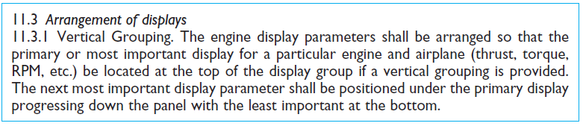
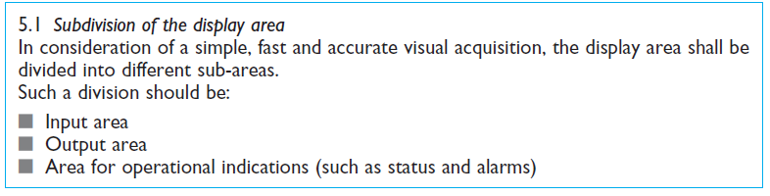
Sample design standards for displays
A typical example of a military standard
(b) From German standard DIN 66 234 Part 3 (1984)

Slide 7

Sample design standards for displays
(c) From US military standard MIL-STD-1472C, revised

Slide 8
ISO standard 9241
Usability specification, applies equally to both hardware and software design.
Definition
Usability : The effectiveness, efficiency and satisfaction with which specified users achieve specified goals in particular environments.

Slide 9
Usability
Effectiveness :The accuracy and completeness with which specified users can achieve specified goals in particular environments.
Efficiency :The resources expended in relation to the accuracy and completeness of goals achieved.
Satisfaction :The comfort and acceptability of the work system to its users and other people affected by its use.

Slide 10
GUIDELINES

Slide 11
Guidelines
Guidelines are translating detailed design specifications into actual implementation.
Guidelines for interactive design
Data Entry
Data Display
Sequence Control
User Guidance
Data Transmission
Data Protection

Slide 12
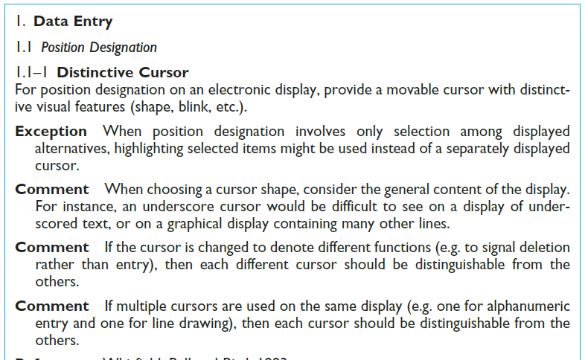

Slide 13
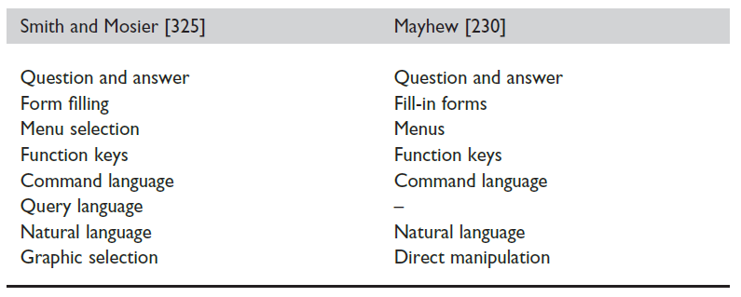
Dialog styles
Guidelines for user communicates input to the system, including how the system presents the communication device.
Eight different dialog styles

Slide 14
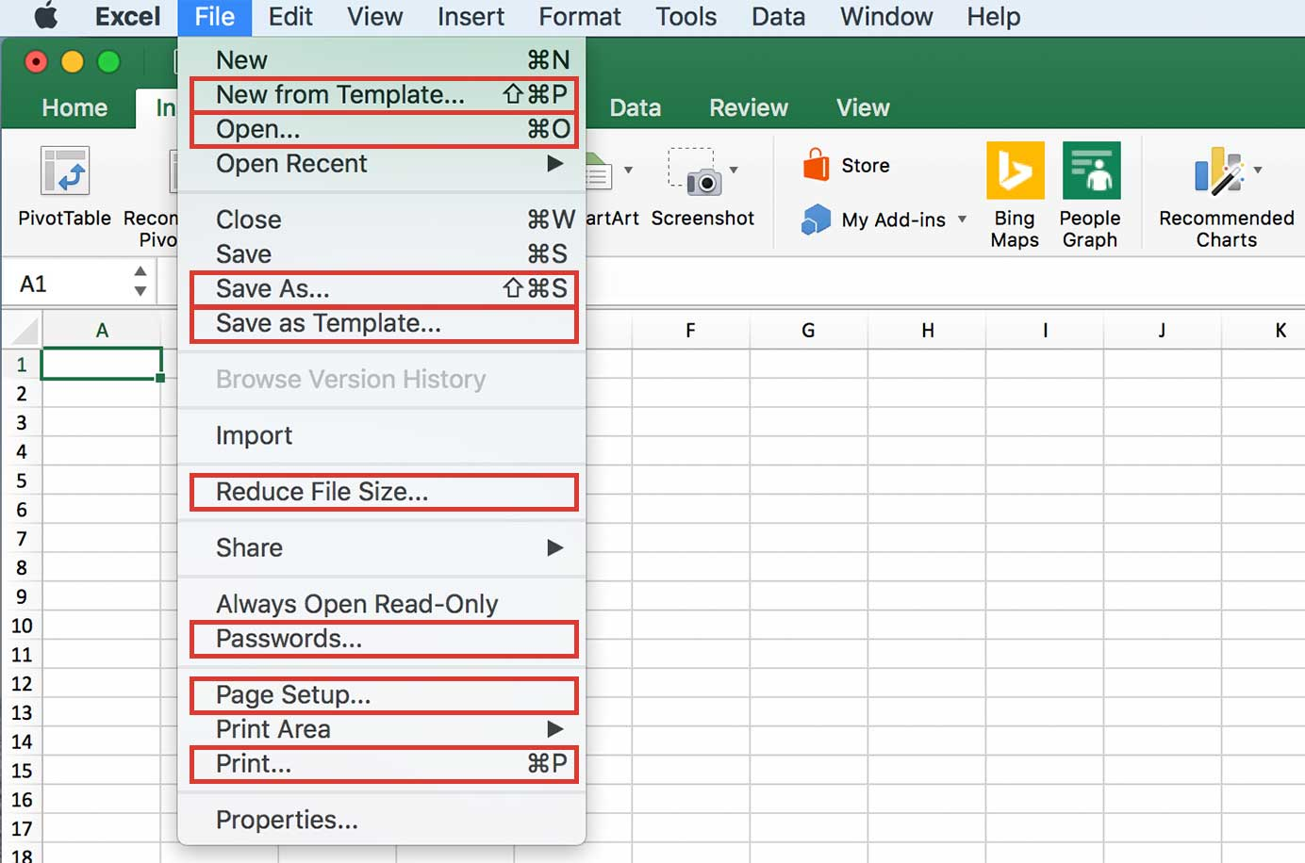
Apple’s Human Interface Guidelines
Abstract guidelines to more specific and automated ones
Apple’s Human Interface Guidelines: the Apple Desktop Interface.
Apple guidelines is consistency:
Apple provides is the ‘noun–verb’ ordering guideline: the user first selects an object (the noun) from the visible set on the Desktop and then selects an operation (the verb) to be applied to the object.

Slide 15
Apple’s Human Interface Guidelines
User control:
The user, not the computer, initiates and controls all actions.
Dialog initiative involves a trade-off between user freedom and system protection

Slide 16
Graphical user interface (GUI) Guidelines
Style Guides
Screen real estate is not an issue.
use of toolkits which provide high-level widgets
each of these GUIs has its own look and feel
guides for the look and feel of a GUI promote the consistency
elements of the WIMP interface.
Grouping items in the same menu
Use white space between long groups of controls on menus or in short group.

Slide 17
Universal design

Slide 18
Multi-modal vs. Multi-media
Multi-modal systems
Multi-modal systems are those that use more than one human input channel (senses) in the interaction
Used in a range of applications particularly good for users with special needs, and virtual reality
Ex: visual and aural senses: A text processor may speak the words as well as echoing them to the screen
These systems may
Sound (speech and non-speech), Touch, Handwriting and Gestures.

Slide 19
Multi-modal vs. Multi-media
Multi-media systems
Use a number of different media to communicate information
Sounds
Text
Hypertext
Animation
Video
Gestures
Vision
Ex: A computer based teaching system may use video, sound, animation, text and still images

Slide 20
Why multi-modal interaction?
MMI is not just about enhancing the richness of the interaction but also about redundancy
Redundant system provide the same information through a range of channels
Information presented graphically is also captioned in readable text or speech
The aim is to provide at least an equivalent experience to all, regardless of their primary channel of interaction

Slide 21
Sound in the interface
Sound is an important contributor to universal design
There are two types of sound
Speech
Speech recognition
Speech synthesis
Non-speech
Auditory icons
Earcons

Slide 22
Speech
Human beings have a great and natural mastery of speech
Makes it difficult to appreciate the complexities but it’s an easy medium for communication
Speech recognition
Speech synthesis

Slide 23
Speech recognition
Speech recognition is recognizing the speech by the computer
There are various methods to do
Pattern recognition
Hidden Markov Model (HMM)
Neural networks

Slide 24
Speech Recognition Problems
Different people speak differently:
accent, intonation, stress, idiom, volume, etc.
The syntax of semantically similar sentences may vary.
Background noises can interfere.
People often “ummm.....” and “errr.....”
Words not enough - semantics needed as well
requires intelligence to understand a sentence
context of the utterance often has to be known
also information about the subject and speaker
e.g. even if “Errr.... I, um, don’t like this” is recognised, it is a fairly useless piece of information on it’s own

Slide 25
Speech Recognition: useful?
Single user or limited vocabulary systems e.g. computer dictation
Open use, limited vocabulary systems can work satisfactorily e.g. some voice activated telephone systems
general user, wide vocabulary systems … … still a problem
Great potential, however
when users hands are already occupied e.g. driving, manufacturing
for users with physical disabilities
lightweight, mobile devices

Slide 26
Speech synthesis
The generation of speech
For those who are blind or partially sighted, synthesized speech offers an output medium
Screen readers are software packages that read the contents of a computer screen, using synthesized speech

Slide 27
Speech Synthesis: useful?
Successful in certain constrained applications when the user:
is particularly motivated to overcome problems
has few alternatives
Examples:
screen readers
read the textual display to the user
utilised by visually impaired people
Warning signals
spoken information sometimes presented to pilots whose visual and haptic skills are already fully occupied

Slide 28
Non speech
Non speech includes such as boings, bangs, squeaks, clicks etc.
Commonly used for warnings and alarms
Evidence to show they are useful
Fewer typing mistakes with key clicks
Video games harder without sound
Language/culture independent, unlike speech
Non-speech
Auditory icons
Earcons

Slide 29
Non-Speech: useful?
Dual mode displays:
information presented along two different sensory channels
redundant presentation of information
resolution of ambiguity in one mode through information in another
Sound good for
transient information
background status information
e.g. Sound can be used as a redundant mode in the Apple Macintosh; almost any user action (file selection, window active, disk insert, search error, copy complete, etc.) can have a different sound associated with it.

Slide 30
Auditory icons
Use natural sounds to represent different types of object or action
Natural sounds have associated semantics which can be mapped onto similar meanings in the interaction
E.g. throwing something away ~ the sound of smashing glass

Slide 31
SonicFinder for the Macintosh
Items and actions on the desktop have associated sounds
Folders have a papery noise
Moving files – dragging sound
Problem: not all things have associated meanings Ex: Copying sound of a liquid being poured into a receptacle rising pitch indicates the progress of the copy
Big files have louder sound than smaller ones

Slide 32
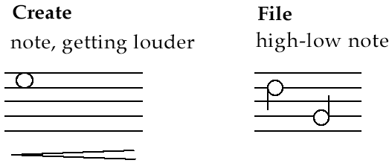
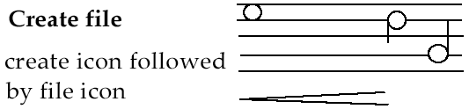
Earcons
Synthetic sounds used to convey information
Structured combinations of notes (motives ) represent actions and objects
Motives combined to provide rich information
compound earcons
multiple motives combined to make one more complicated earcon

Slide 33
Earcons (ctd)
Family earcons
similar types of earcons represent similar classes of action or similar objects: the family of “errors” would contain syntax and operating system errors
Earcons easily grouped and refined due to compositional and hierarchical nature
Harder to associate with the interface task since there is no natural mapping

Slide 34
Touch
Haptic interaction
cutaneous perception
tactile sensation; vibrations on the skin
kinesthetics
movement and position; force feedback
Information on shape, texture, resistance, temperature, comparative spatial factors
Example technologies
Electronic braille displays
Force feedback devices e.g. Phantom
resistance, texture

Slide 35
Touchscreen
Touch screens are replacing traditional users interfaces
Cell phones & handhelds
Tablets
Laptops
Portable gaming devices
Touch screens have one major disadvantages
No physical or mechanical feedback when the screen is pressed or an event occurs
Loss of tactile or haptic feedback

Slide 36
Haptic
Haptics refers to the sense of touch
It is a technology that provides mechanical feedback through the use of vibrations to simulate specific events or effects
Benefits of Haptics
Improves task performance
Increases user satisfaction
Provides a more realistic experience

Slide 37
Handwriting recognition
Handwriting is another communication mechanism which we are used to in day-to-day life
Technology
Handwriting consists of complex strokes and spaces
Captured by digitising tablet
strokes transformed to sequence of dots
large tablets available
suitable for digitising maps and technical drawings
smaller devices, some incorporating thin screens to display the information
PDAs such as Palm Pilot
tablet PCs

Slide 38
Handwriting recognition (ctd)
Problems
personal differences in letter formation
co-articulation effects
Breakthroughs:
stroke not just bitmap
special ‘alphabet’ – Graffeti on PalmOS
Current state:
usable – even without training
but many prefer keyboards!

Slide 39
Gesture
Applications
gestural input - e.g. “put that there”
sign language
Technology
data glove
position sensing devices e.g MIT Media Room
Benefits
natural form of interaction - pointing
enhance communication between signing and non-signing users
Problems
user dependent, variable and issues of coarticulation

Slide 40
Designing for diversity

Slide 41
Users with disabilities
Visual impairment
Screen readers using synthesized speech
The use of sound such as speech, earcons and auditory icons (SonicFinder)
The use of touch in haptic technology
force feedback such as
edges, textures and behaviour used to indicate objects and actions
Hearing impairment
Text communication such as E-mail and instant messaging
Gesture recognition
Captioning audio content – A sign of good universal design !
Physical impairment
Speech Input/Output for those without speech difficulties
Eye gaze system which tracks eye movement to control the cursor
Gesture, Predictive Systems (e.g. Reactive keyboard)

Slide 42
Users with disabilities (contd.)
Speech impairment
Speech synthesis,
Text communication
Dyslexia (cognitive impairment)
Speech input, output
Consistent navigation structure
Clear signposting cues
Color coding
Some graphical information can make the meaning of text easier to grasp

Slide 43
… plus …
Age groups
Older people e.g. disability aids, memory aids, communication tools to prevent social isolation
Children e.g. appropriate input/output devices, involvement in design process
Cultural differences
Influence of nationality, generation, gender, race, sexuality, class, religion, political persuasion etc. on interpretation of interface features
E.g. interpretation and acceptability of language, cultural symbols, gesture and colour

